Slide 1
Mental Health and Productivity Analysis
Presented by
Jyoti Bhati and Anushka Bhawalkar

Slide 2
Introduction
This project analyzes the relationship between mental health and productivity in the workplace.
Key Objectives:
Understand how mental health affects work interference
Identify factors influencing mental well-being
Assess workplace support and its impact

Slide 3
Data & Methodology
• Data collected from a survey on mental health in the workplace
• Key variables: work interference, mental health treatment, workplace benefits
• Analyzed using Python (Pandas, Matplotlib) and visualized in HTML format

Slide 4
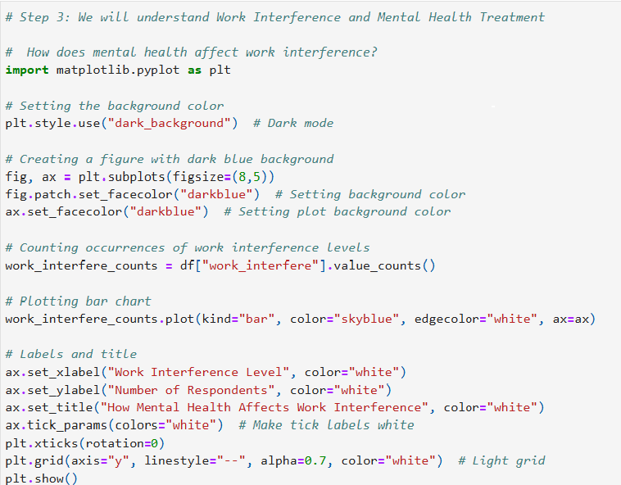
Analyzing Work Interference and Mental Health Treatment

Slide 5
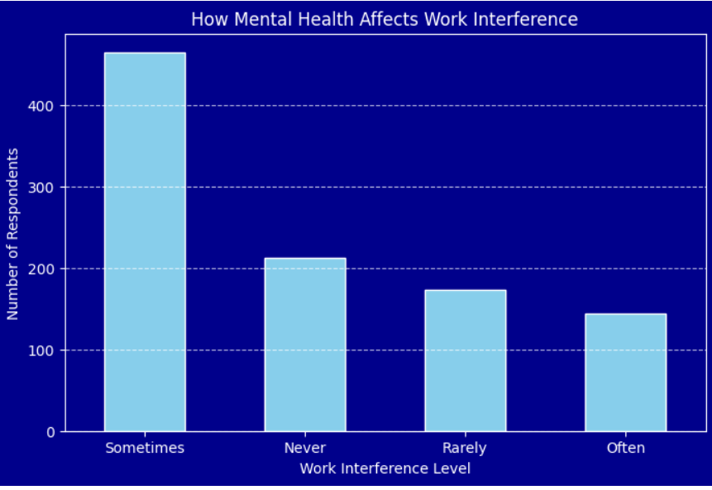
How Mental Health affects Work Interference

Slide 6
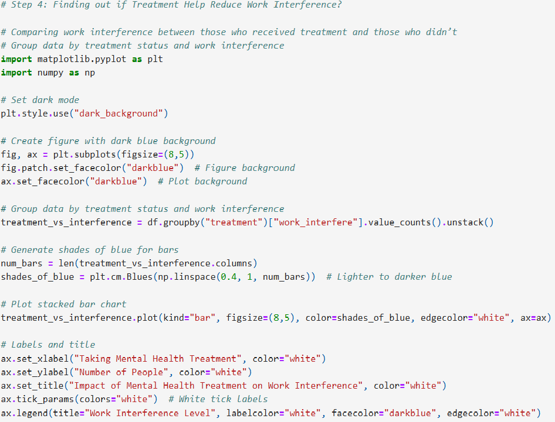
Does Treatment Help Reduce Work Interference?

Slide 7
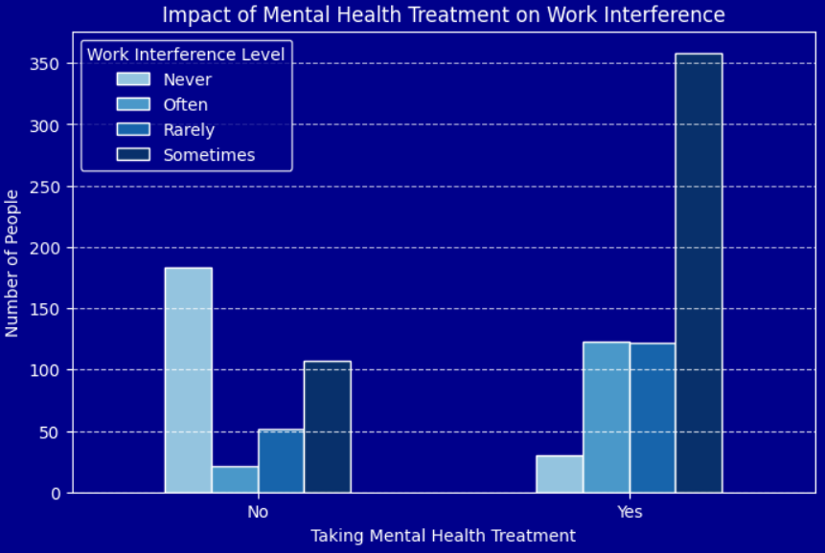
Impact of Mental Health Treatment

Slide 8
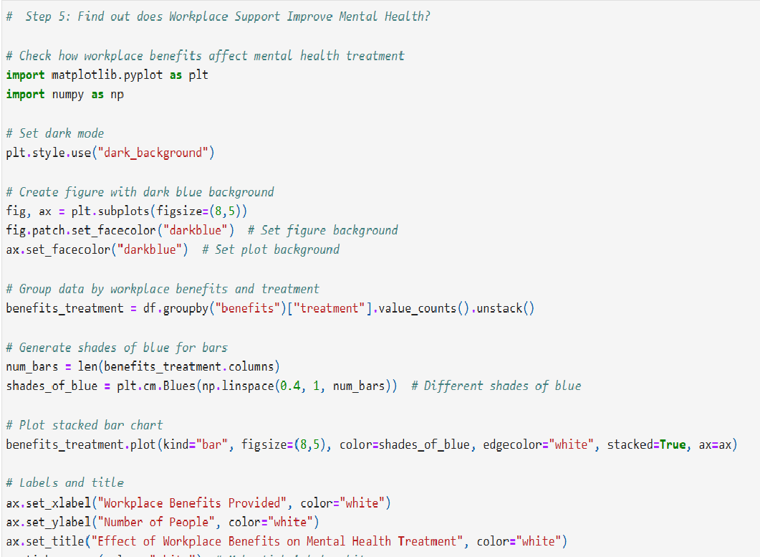
Does Workplace Support Improve Mental Health?

Slide 9
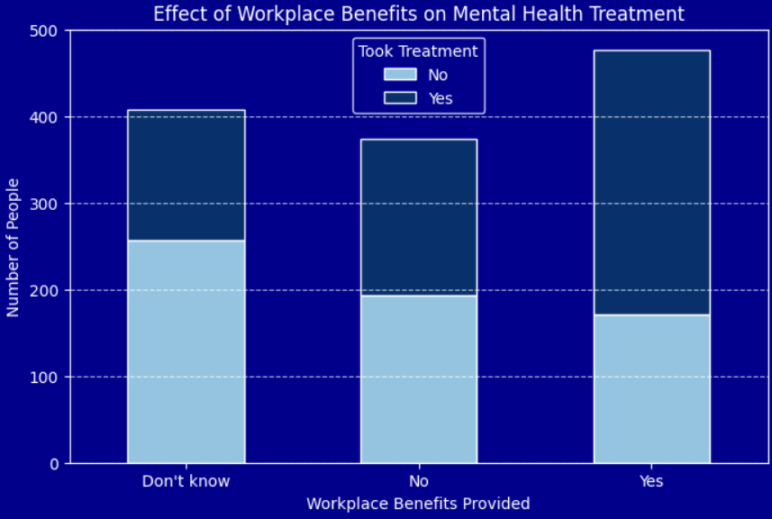
Effects of Workplace Benefits on Mental Health Treatment

Slide 10
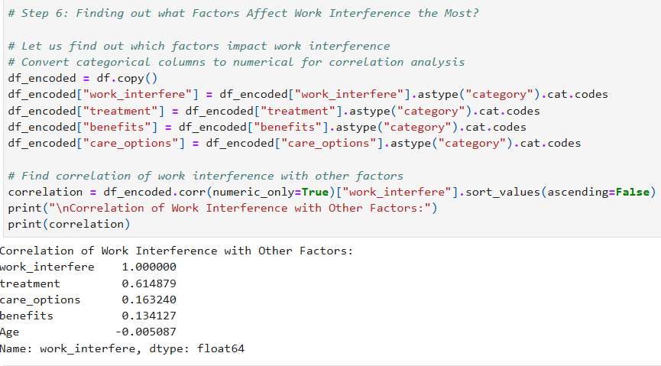
What Factors Affect Work Interference?

Slide 11
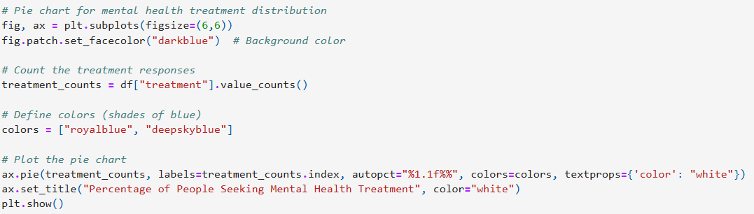
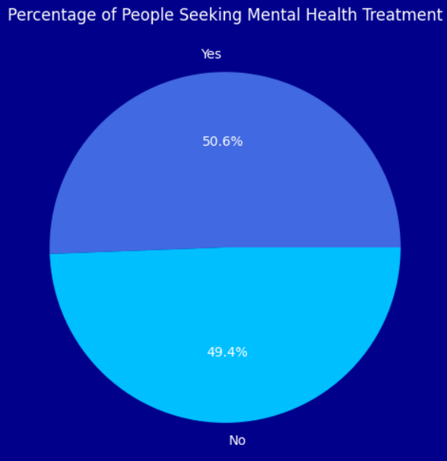
Percentage of people seeking mental health treatment.

Slide 12
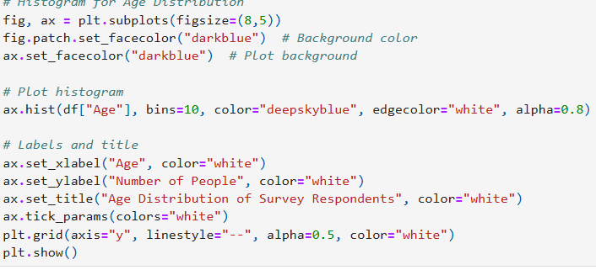
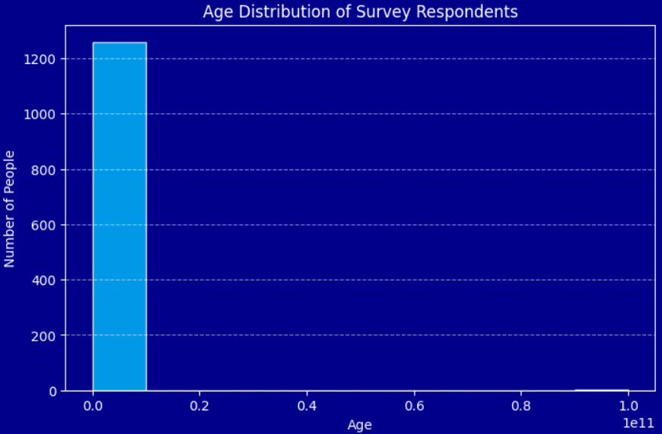
Age distribution of respondents

Slide 13
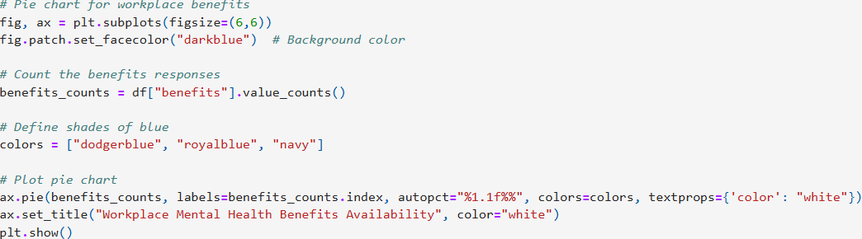
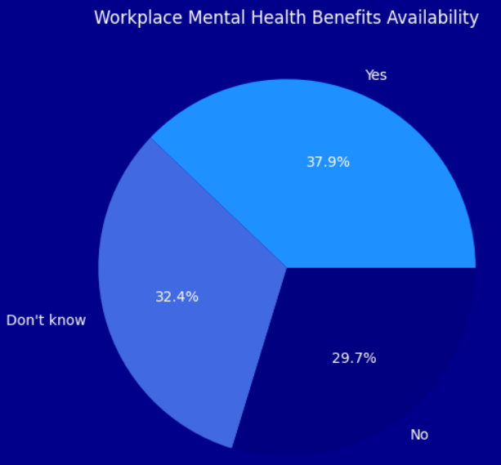
Workplace mental health benefits availability.

Slide 14
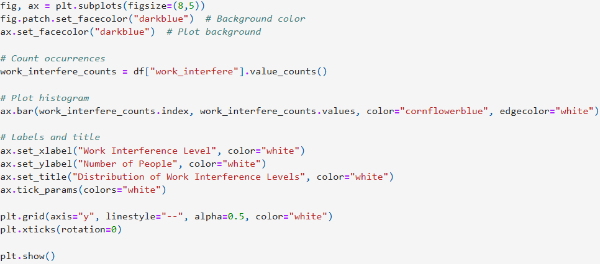
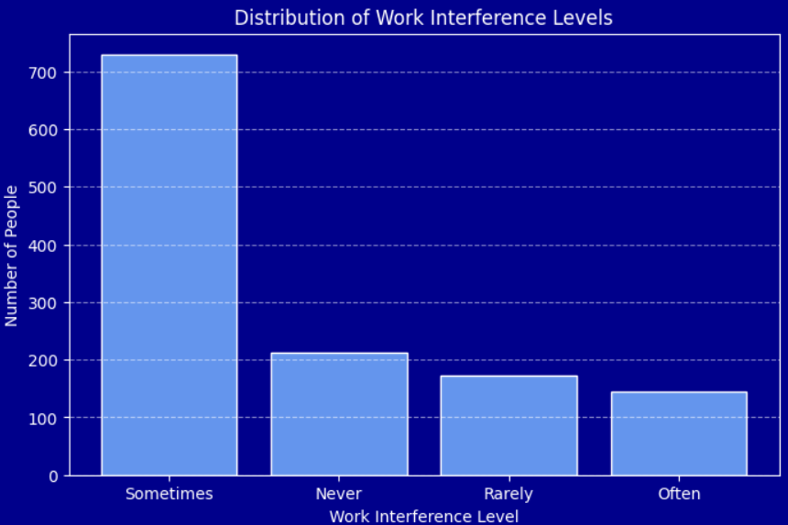
Work Interference Levels

Slide 15
Conclusion & Recommendations
Mental health significantly impacts work productivity.
Companies should offer mental health benefits to improve employee performance.
Future work: Expand analysis with more diverse data and predictive modeling.

